Slide 1
CS4038
DATA MINING
LECTURE # 14
SPRING 2024
FAST – NUCES, CFD CAMPUS
AYESHA LIAQAT
ayesha.liaqat@nu.edu.pk

Slide 2
TODAY’S TOPICS
Decision tree classifier
Attribute split
Measure of Impurity: Gini index
Finding the best split: Gain

Slide 3
DECISION TREE
A CLASSIFICATION TECHNIQUE

Slide 4
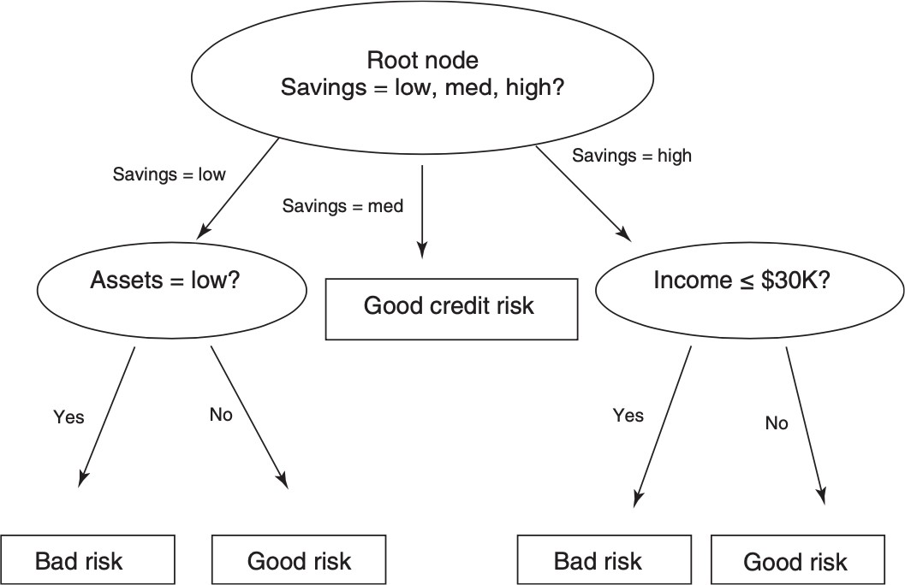
DECISION TREE
A collection of decision nodes, connected by branches, extending downward from the root node until terminating in leaf nodes.
Leaf nodes are target or class variable, credit risk, with two possible values: good risk or bad risk
Predictor variables are: Savings (low, medium, high); Assets (low, not low); Income (<=30K,
>30K)

Slide 5
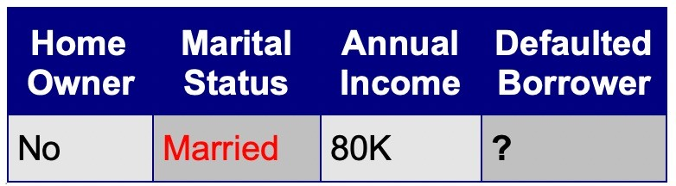
ANOTHER EXAMPLE OF DECISION TREE
categorical
categorical
continuous
MarSt
Single, Divorce
d
class
Married
ID | Home Owner | Marital Status | Annual Income | Defaulted Borrower
1 | Yes | Single | 125K | No
2 | No | Married | 100K | No
3 | No | Single | 70K | No
4 | Yes | Married | 120K | No
5 | No | Divorced | 95K | Yes
6 | No | Married | 60K | No
7 | Yes | Divorced | 220K | No
8 | No | Single | 85K | Yes
9 | No | Married | 75K | No
10 | No | Single | 90K | Yes
NO
Home Owner
Yes
No
NO
Income
< 80K
> 80K
NO
YES
Test Data
10
There can be more than one tree that fits the same data!

Slide 6
DECISION TREE INDUCTION
Many Algorithms:
Hunt’s Algorithm (one of the earliest)
CART
ID3, C4.5
SLIQ, SPRINT

Slide 7
GENERAL STRUCTURE OF HUNT’S ALGORITHM
ID | Home Owner | Marital Status | Annual Income | Defaulted Borrower
1 | Yes | Single | 125K | No
2 | No | Married | 100K | No
3 | No | Single | 70K | No
4 | Yes | Married | 120K | No
5 | No | Divorced | 95K | Yes
6 | No | Married | 60K | No
7 | Yes | Divorced | 220K | No
8 | No | Single | 85K | Yes
9 | No | Married | 75K | No
10 | No | Single | 90K | Yes
Let D_{t} be the set of training records that reach a node t
General Procedure:
If D_{t} contains records that belong the same class y_{t}, then t is a leaf node labeled as y_{t}
If D_{t} contains records that belong to more than one class, use an attribute test to split the data into smaller subsets.
Recursively apply the procedure to each subset.
10
D_{t}
?

Slide 8
HUNT’S ALGORITHM
Home
Owner
Yes No
Defaulted = No Defaulted = No
(3,0) (4,3)
(b)
Home Owner
Yes No
Defaulted = No Marital Status
Defaulted = No
(7,3)
(a)
ID | Home Owner | Marital Status | Annual Income | Defaulted Borrower
1 | Yes | Single | 125K | No
2 | No | Married | 100K | No
3 | No | Single | 70K | No
4 | Yes | Married | 120K | No
5 | No | Divorced | 95K | Yes
6 | No | Married | 60K | No
7 | Yes | Divorced | 220K | No
8 | No | Single | 85K | Yes
9 | No | Married | 75K | No
10 | No | Single | 90K | Yes
Home
Owner
Yes No
Defaulted = No Marital
Status
(3,0)Single,
Divorced ^{Married}
Defaulted = Yes Defaulted = No
(1,3) (3,0)
(c)
(3,0S) ingle,
Divorced ^{Married}
_{Annual} Defaulted = No
Income _{(3,0)}
< 80K >= 80K
Defaulted = No Defaulted = Yes
(1,0) (0,3)
(d)
10

Slide 9
HUNT’S ALGORITHM
Home Owner
Defaulted = No
Yes
No
(7,3)
(a)
Defaulted = No
Defaulted = No
(3,0)
(4,3)
ID | Home Owner | Marital Status | Annual Income | Defaulted Borrower
1 | Yes | Single | 125K | No
2 | No | Married | 100K | No
3 | No | Single | 70K | No
4 | Yes | Married | 120K | No
5 | No | Divorced | 95K | Yes
6 | No | Married | 60K | No
7 | Yes | Divorced | 220K | No
8 | No | Single | 85K | Yes
9 | No | Married | 75K | No
10 | No | Single | 90K | Yes
(b)
Home
Owner
Yes No
Defaulted = No Marital Status
Single,
(3,0)_{Divorced} Married
_{Annual} Defaulted = No
Income
< 80K >= 80K ^{(3,0)}
Defaulted = No Defaulted = Yes
(1,0) (0,3)
(d)
Home
Owner
Yes No
Defaulted = No Marital
Status
Single,
^{(3,0)}Divorced ^{Married}
Defaulted = Yes Defaulted = No
(1,3) (3,0)
(c)
10

Slide 10
HUNT’S ALGORITHM
Home Owner
Defaulted = No
Yes
No
(7,3)
(a)
Defaulted = No
Defaulted = No
(3,0)
(4,3)
ID | Home Owner | Marital Status | Annual Income | Defaulted Borrower
1 | Yes | Single | 125K | No
2 | No | Married | 100K | No
3 | No | Single | 70K | No
4 | Yes | Married | 120K | No
5 | No | Divorced | 95K | Yes
6 | No | Married | 60K | No
7 | Yes | Divorced | 220K | No
8 | No | Single | 85K | Yes
9 | No | Married | 75K | No
10 | No | Single | 90K | Yes
(b)
Home
Owner
Yes No
Defaulted = No Marital Status
Single,
(3,0)_{Divorced} Married
_{Annual} Defaulted = No
Income
< 80K >= 80K ^{(3,0)}
Defaulted = No Defaulted = Yes
(1,0) (0,3)
(d)
Home Owner
Yes
No
Defaulted = No
Marital Status
_{(3,0)} Single,
Married
Divorced
Defaulted = Yes
Defaulted = No
10
(1,3)
(3,0)
(c)

Slide 11
HUNT’S ALGORITHM
Home Owner
Defaulted = No
Yes
No
(7,3)
(a)
Defaulted = No
Defaulted = No
(3,0)
(4,3)
ID | Home Owner | Marital Status | Annual Income | Defaulted Borrower
1 | Yes | Single | 125K | No
2 | No | Married | 100K | No
3 | No | Single | 70K | No
4 | Yes | Married | 120K | No
5 | No | Divorced | 95K | Yes
6 | No | Married | 60K | No
7 | Yes | Divorced | 220K | No
8 | No | Single | 85K | Yes
9 | No | Married | 75K | No
10 | No | Single | 90K | Yes
(b)
Home Owner
Home Owner
Yes
No
Yes
No
Defaulted = No
Marital Status
Defaulted = No
Marital Status
_{(3,0)} Single,
Married
Divorced
_{(3,0)} Single,
Married
Annual Income
Defaulted = No
Divorced
Defaulted = Yes
Defaulted = No
< 80K
>= 80K
10
(1,3)
(3,0)
Defaulted = No
Defaulted = Yes
(c)
(d)
Complete the node values yourself

Slide 12
HUNT’S ALGORITHM
Home Owner
Defaulted = No
Yes
No
(7,3)
(a)
Defaulted = No
Defaulted = No
(3,0)
(4,3)
ID | Home Owner | Marital Status | Annual Income | Defaulted Borrower
1 | Yes | Single | 125K | No
2 | No | Married | 100K | No
3 | No | Single | 70K | No
4 | Yes | Married | 120K | No
5 | No | Divorced | 95K | Yes
6 | No | Married | 60K | No
7 | Yes | Divorced | 220K | No
8 | No | Single | 85K | Yes
9 | No | Married | 75K | No
10 | No | Single | 90K | Yes
(b)
Home Owner
Home Owner
Yes
No
Yes
No
Defaulted = No
Marital Status
Defaulted = No
Marital Status
_{(3,0)} Single,
Married
Divorced
_{(3,0)} Single,
Married
Annual Income
Defaulted = No
Divorced
(3,0)
Defaulted = Yes
Defaulted = No
< 80K
>= 80K
10
(1,3)
(3,0)
Defaulted = No
Defaulted = Yes
(c)
(1,0)
(d)
(0,3)

Slide 13
DESIGN ISSUES OF DECISION TREE INDUCTION
How should training records be split?
Method for expressing test condition
– depending on attribute types
Measure for evaluating the goodness of a test condition
How should the splitting procedure stop?
Stop splitting if all the records belong to the same class or have identical attribute values
A n y other criteria for Early termination

Slide 14
METHODS FOR EXPRESSING TEST CONDITIONS
Depends on attribute types
Binary (only two possibilities)
Nominal
Ordinal
Continuous

Slide 15
TEST CONDITION FOR NOMINAL ATTRIBUTES
Marital Status
Multi-way split:
– Use as many partitions as distinct values.
Single
Divorced
Married
Binary split:
– Divides values into two subsets
Marital Status
Marital Status
Marital Status
OR
OR
{Married}
{Single, Divorced}
{Single}
{Married, Divorced}
{Single, Married}
{Divorced}

Slide 16
TEST CONDITION FOR ORDINAL ATTRIBUTES
Shirt Size
Multi-way split:
– Use as many partitions as distinct values.
Small
Medium
Large
Extra Large
Shirt Size
Shirt Size
Shirt Size
Binary split:
– Divides values into two subsets
{Small, Medium}
{Large, Extra Large}
{Small} {Medium, Large,
Extra Large}
{Small, Large}
{Medium, Extra Large}
This grouping violates order property
Is there any issue in these binary splits?

Slide 17
TEST CONDITION FOR CONTINUOUS ATTRIBUTES
Annual Income
> 80K?
Annual Income?
< 10K
> 80K
Yes
No
[10K,25K)
[25K,50K)
[50K,80K)
(i) Binary split
(ii) Multi-way split

Slide 18
SPLITTING CONTINUOUS ATTRIBUTES
Different ways of handling
Discretization to form an ordinal categorical attribute
Ranges can be found by equal interval bucketing, equal frequency bucketing (percentiles), or clustering.
Static – discretize once at the beginning
Dynamic – repeat at each node
Binary Decision: (A < v) or (A ≥ v)
consider all possible splits and finds the best cut
can be more compute intensive

Slide 19
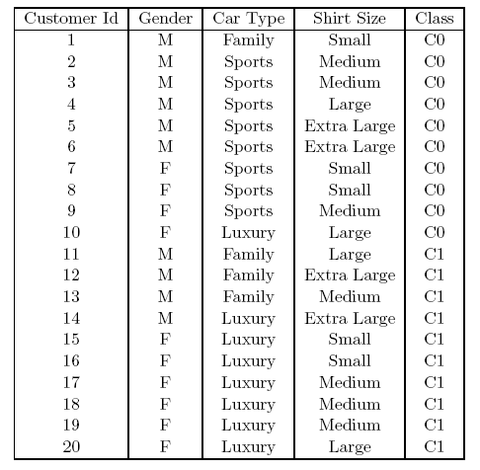
HOW TO DETERMINE THE BEST SPLIT
Before Splitting: 10 records of class 0,
10 records of class 1
Gender
Car Type
Customer ID
Yes
No
Family
Sports
Luxury
c₁
^{c}20
^{c}10 ^{c}11
C0: 6
C1: 4
C0: 4
C1: 6
C0: 1
C1: 3
C0: 8
C1: 0
C0: 1
C1: 7
C0: 1
C1: 0
...
C0: 1
C1: 0
C0: 0
C1: 1
...
C0: 0
C1: 1
Which test condition is the best?

Slide 20
READING MATERIAL
Chapter 4:Tan, Steinbach & Kumar
Chapter 8: Han, Kamber & Pei
38

